Slide 1
Welcome to Fulton County

Slide 2
Library Website - www.fulcolibrary.org

Slide 3
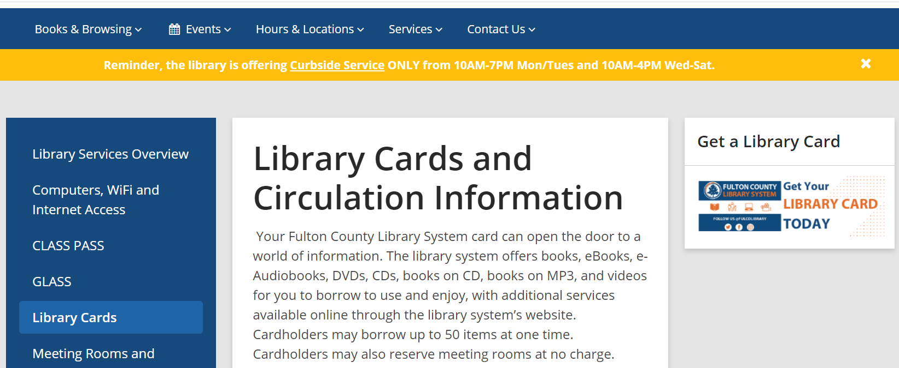
Click Services then Library Cards

Slide 4
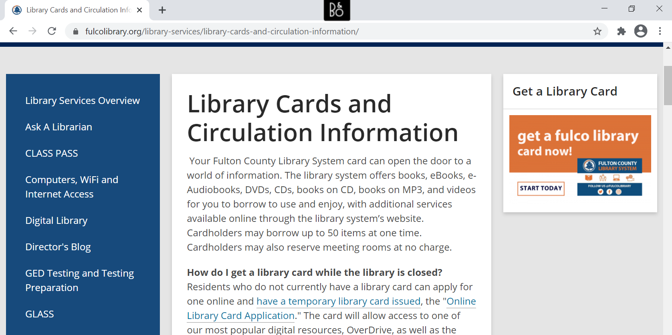

Slide 5
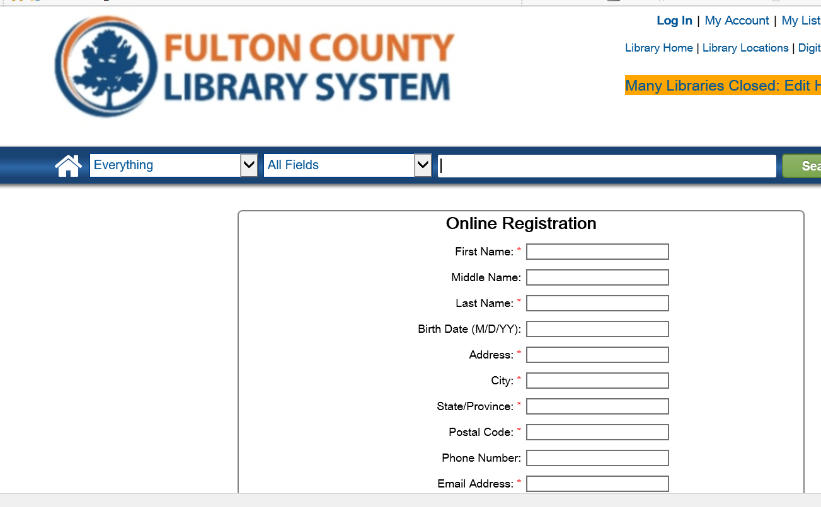
Click Online Library Card Application

Slide 6
All County Employees Receive a Library Card
Complete the library card application
You will receive an email with your new card number
Library card # is D+9 numbers (no space)
Your temporary card is good for 30 days
Visit the branch to obtain your permanent card
Card is valid for 2 years
Access to all library resources

Slide 7
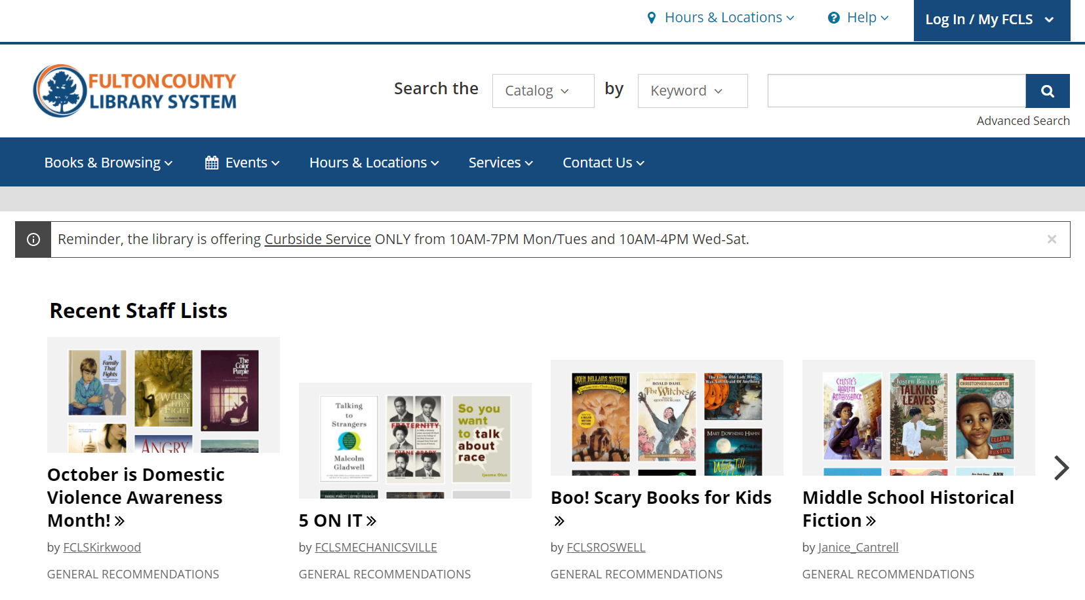
Search the Catalog or Click Books & Browsing

Slide 8
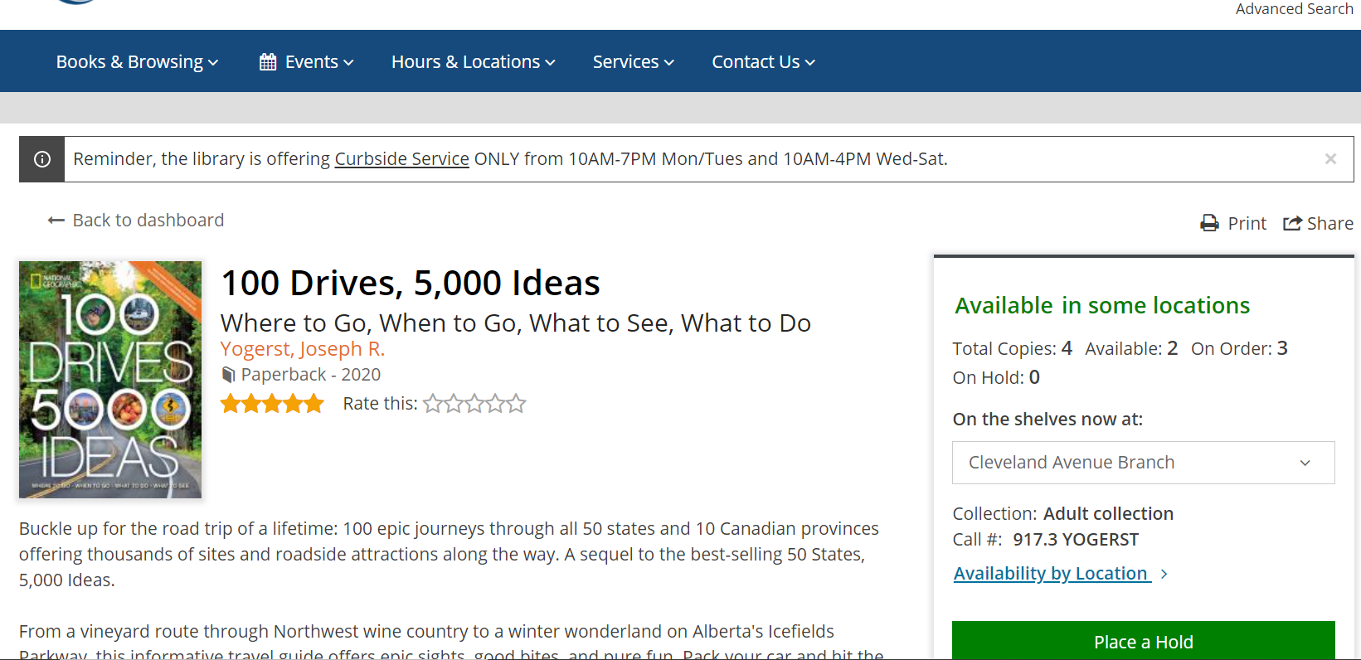
Place a Hold

Slide 9
Library Hours
Monday, Tuesday 10-8
Wednesday - Saturday 10-6

Slide 10
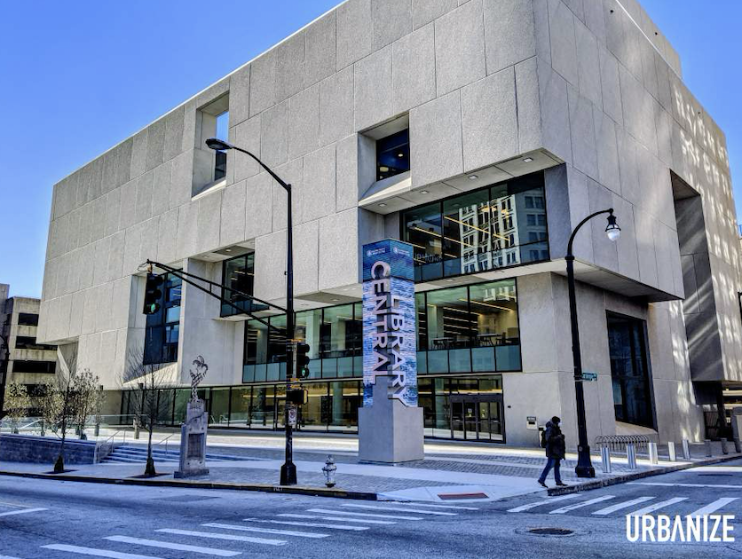
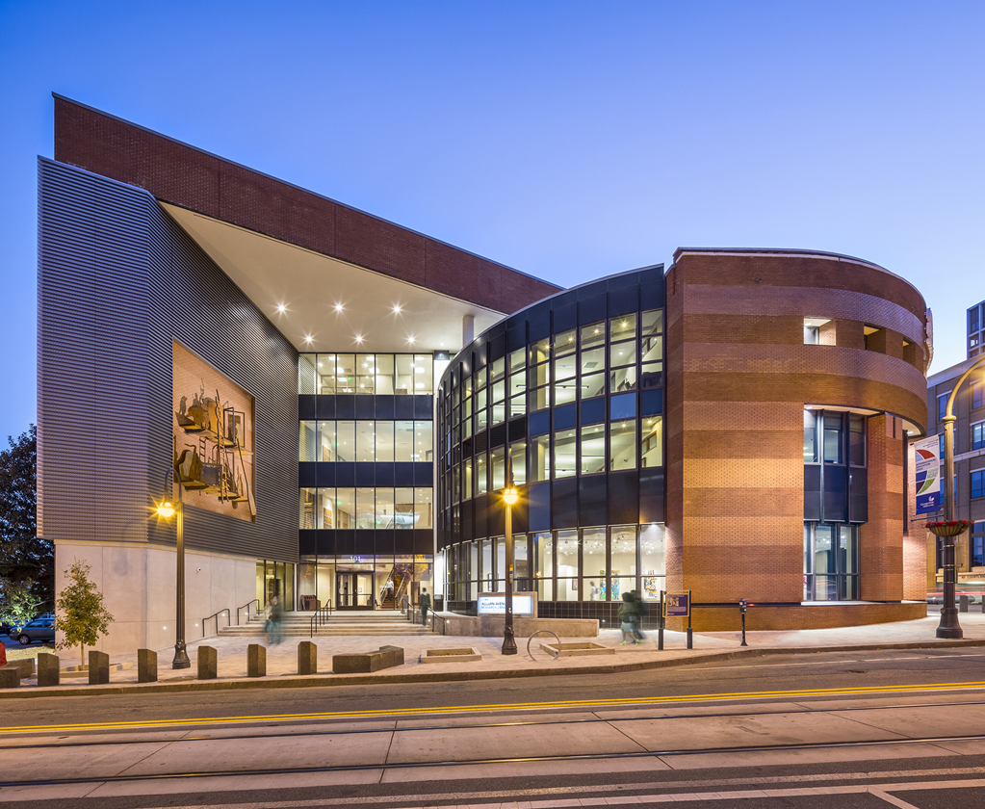
34 Library Locations in Fulton County
Central Library
Auburn Avenue Library on African American Culture and History

Slide 11
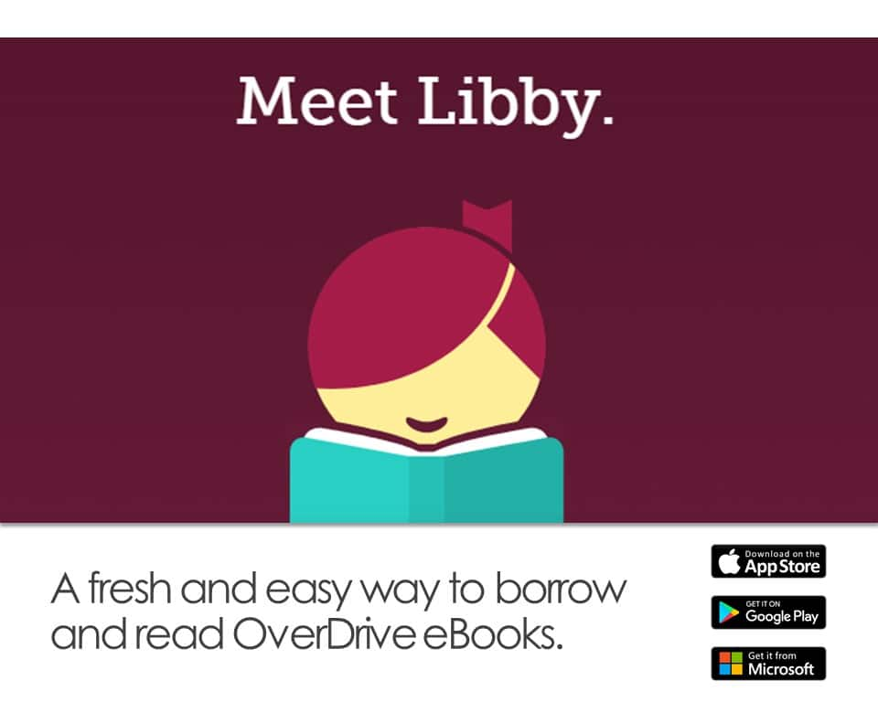
Enjoy our Online eResources
Library Website - fulcolibrary.org
OverDrive
Check out the latest bestseller eBooks and Audiobooks for 7, 14 or 21 days with no late fees.
Hoopla - Borrow 10 items a month. Instantly borrow free digital eBooks, audiobooks, movies, music, comics, and TV shows. Choose from over 800,000 titles.

Slide 12
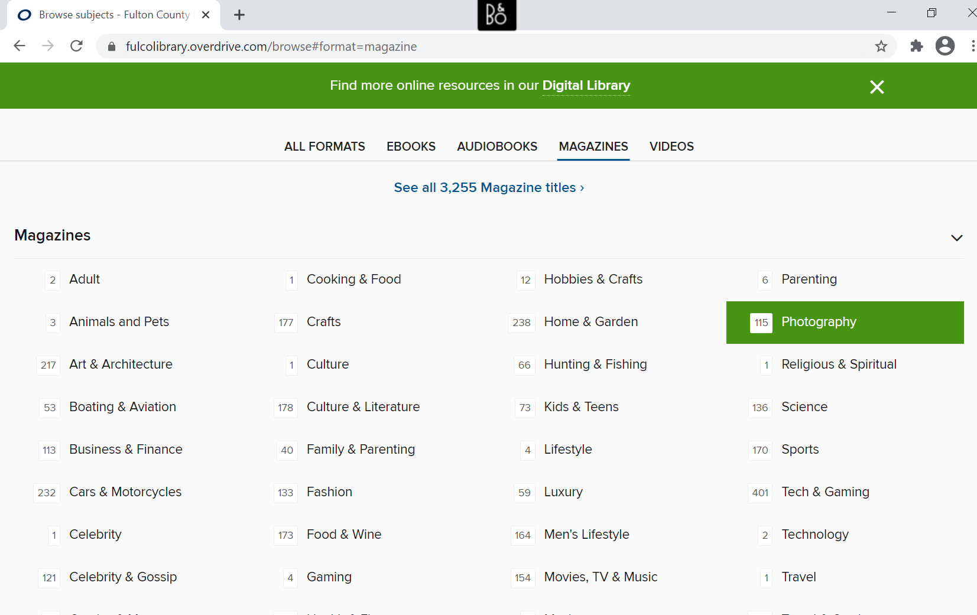
Enjoy Free Magazines and Music
Check out digital magazines in OverDrive
Download or stream music

Slide 13
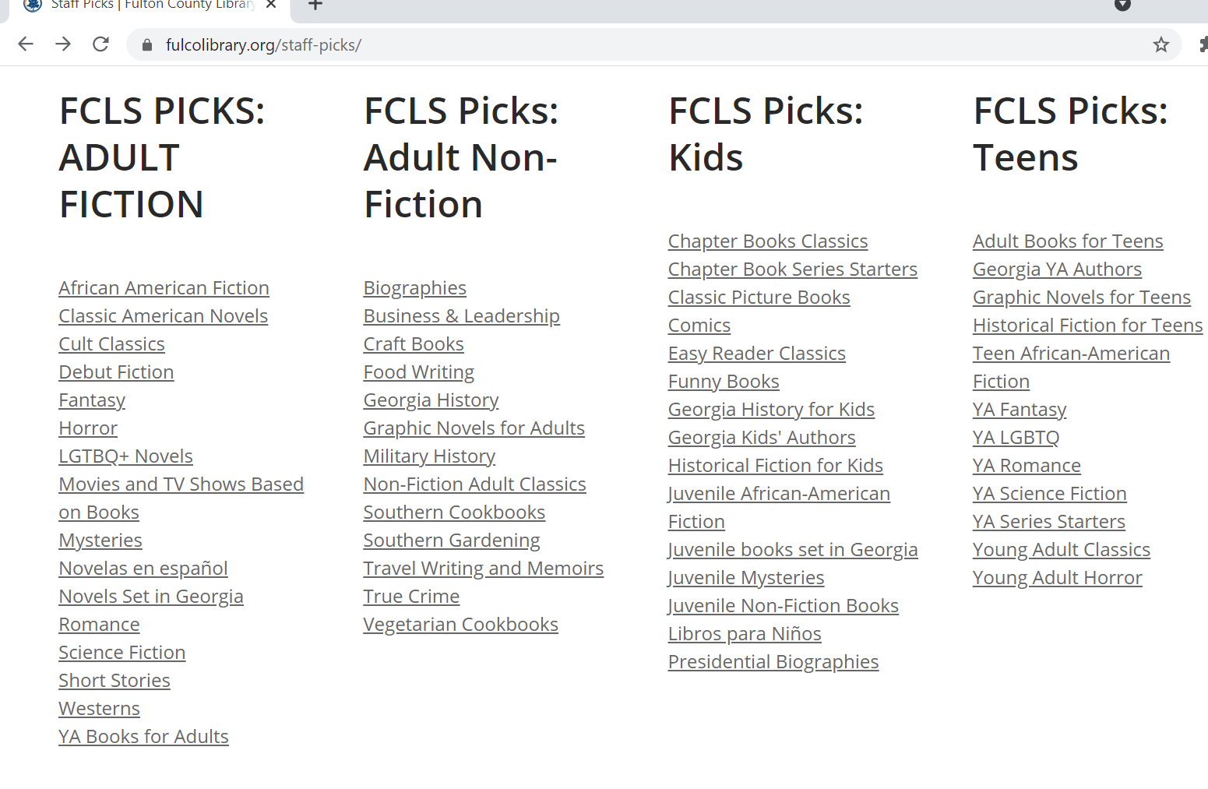
Staff
Picks
Find your next
great read!
Join our Online Book Club!

Slide 14
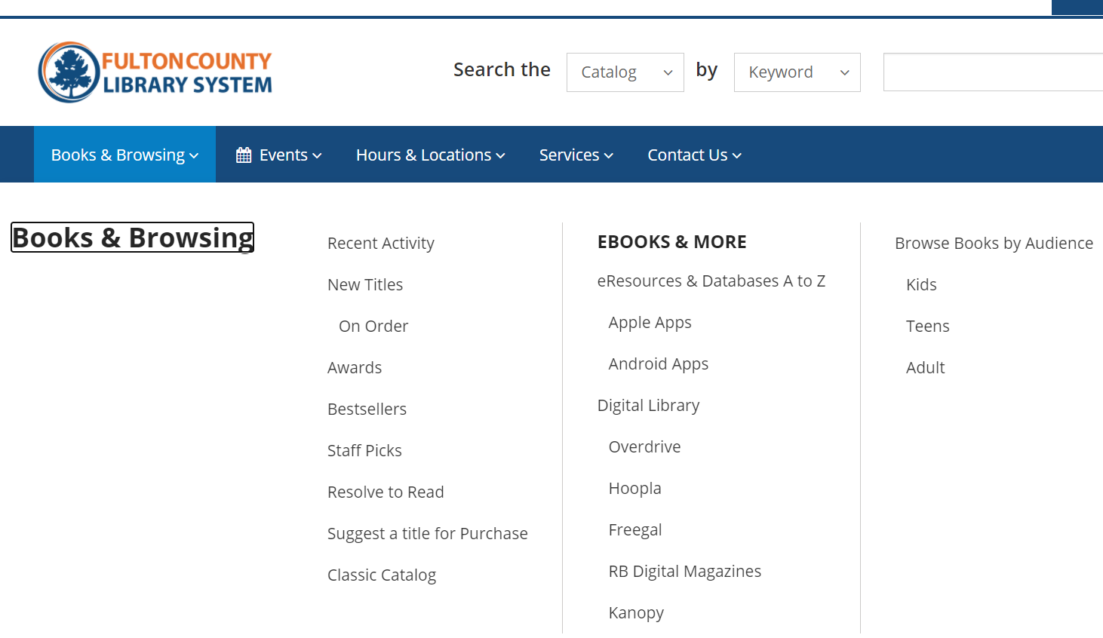
Visit our Digital Library

Slide 15
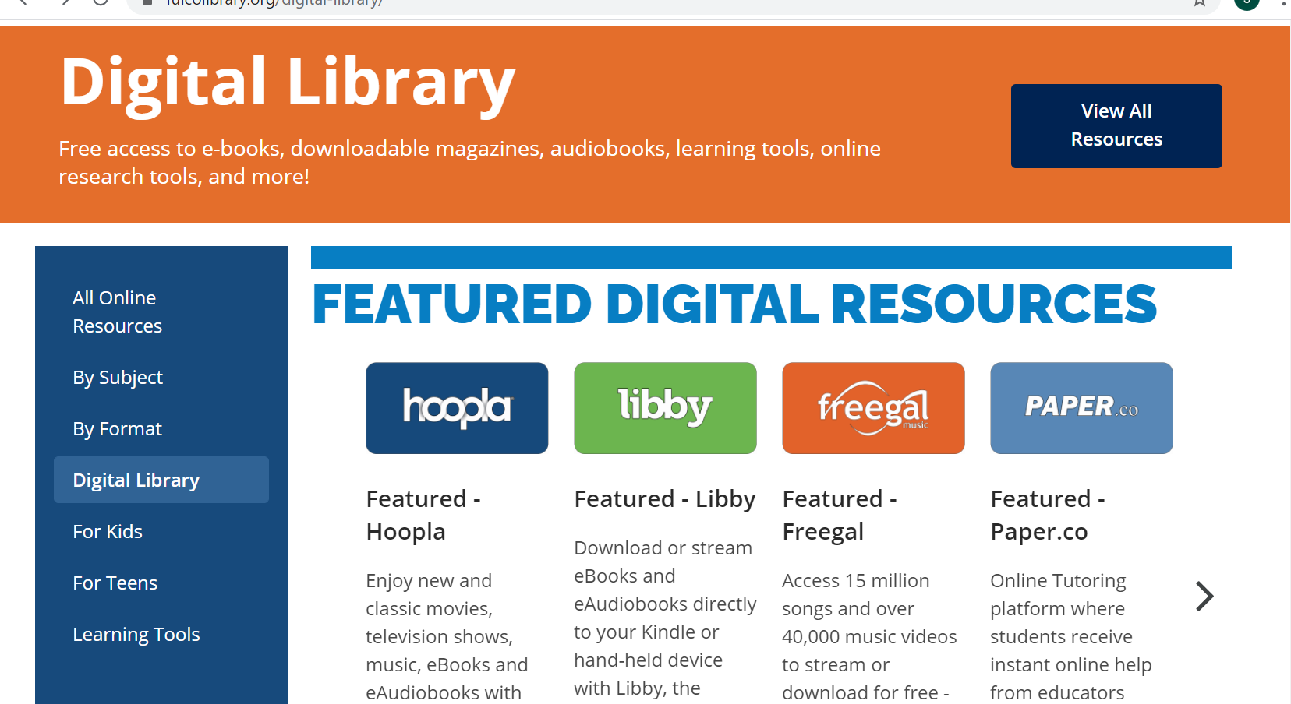

Slide 16
Click Learning Tools
Mango Languages - Prepares learners for realistic conversations and communication in over 70 languages.
Peterson’s Test Prep - Testing guides, full-length practice tests, and tools for scholarship research.

Slide 17
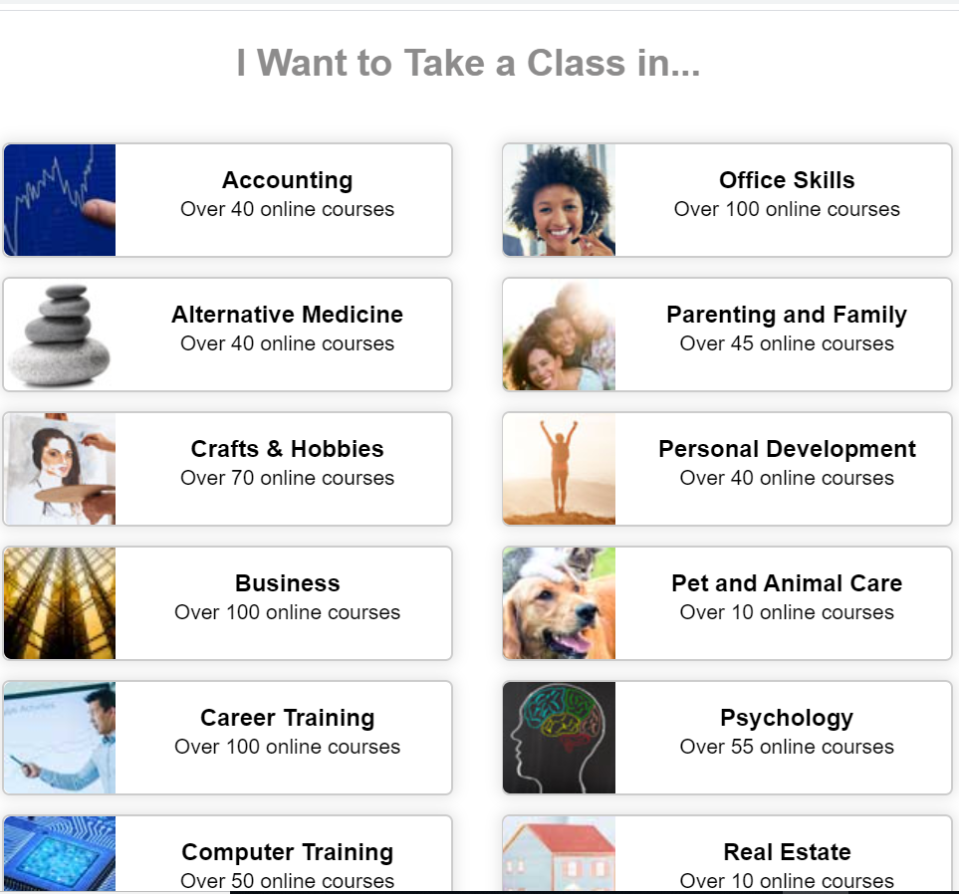
Over 500 online self-paced continuing education classes in a range of subjects related to skills, jobs or personal growth. Certificate of completion provided.

Slide 18
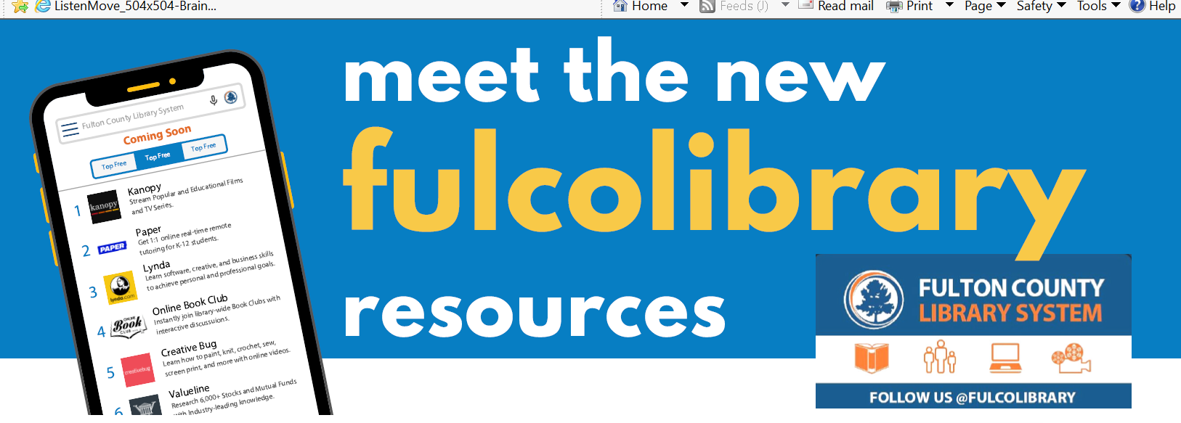
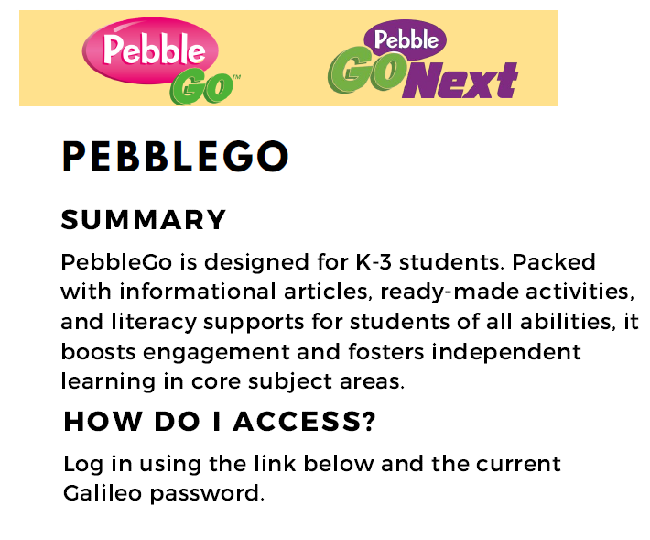

Slide 19
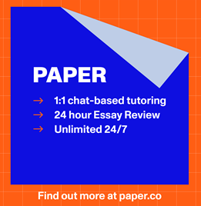
FREE ONLINE TUTORING
Paper - Live help. Students receive instant live help from educators. Essay feedback. Written work is reviewed and annotated by an educator to give students rapid writing feedback.
Tutor.com - Get a tutor 24/7 in 40+ subjects including Math, Science and English. K-12, college and adult learners.

Slide 20
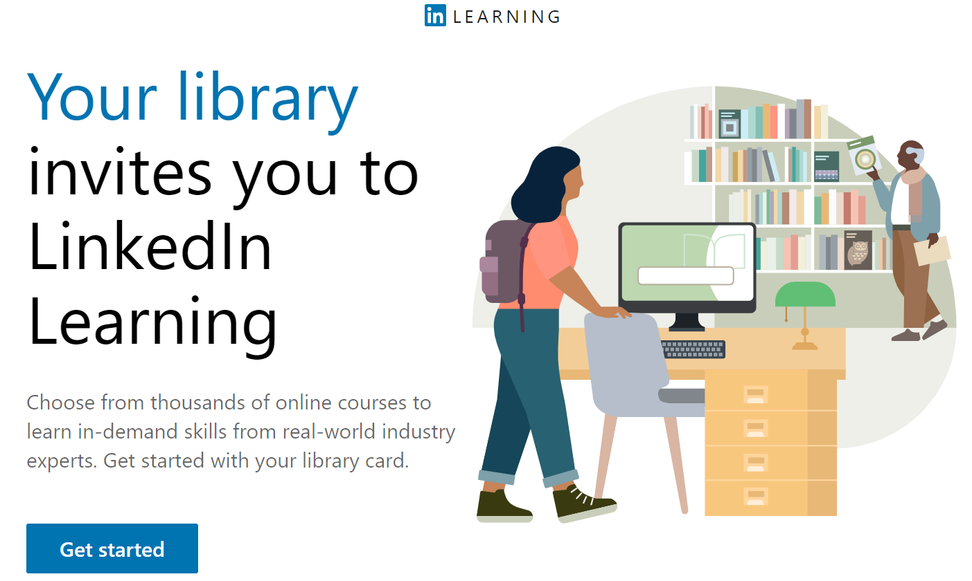
LinkedIn Learning
Enter through library website

Slide 22
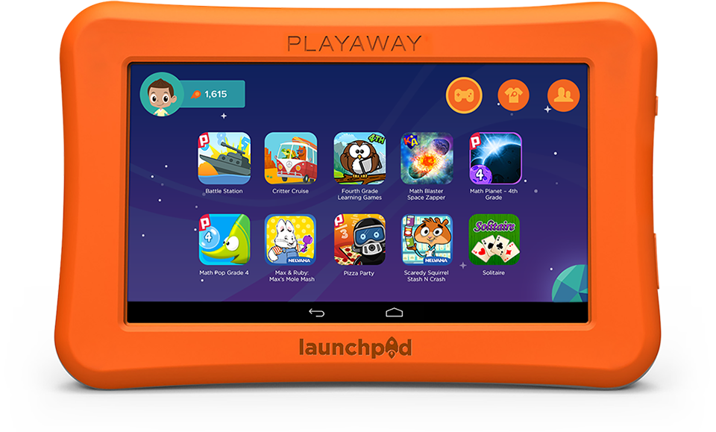
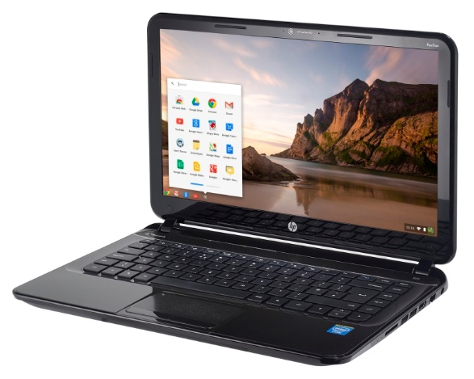
Available to all card holders

Slide 23
Free Attraction Passes

Slide 24
Questions?
Email me at joy.burson@fultoncountyga.gov
www.fulcolibrary.org

