Slide 1

Customer Experience and Solutions
GREAT PLACE, GREAT PEOPLE, GREAT WORK

Slide 2
Fulton County and Customer Service
As a public service entity, Fulton County Government is committed to customer service excellence and has integrated customer service into its model of performance.
The County seeks to enhance the customer experience and provide viable solutions in an effort to better the lives of the citizens it serves.
We aim to deliver five star customer service both externally and internally and this can only be done with engaged employees who are service oriented and customer service focused.

Slide 3
Creating a Customer Service Culture
  AIM:
  Provide a more customer-centric culture, which requires a collaborative approach to successfully transform the organization.
  HOW WE GET THERE:
  Evaluate the customer experience in totality, from end-to-end and not focus specifically on the transactional moment.
  Improve the customer experience by:
  Gaining insight into the unmet needs of our customers;
  Empathize and understand the emotional dimensions of what the customer encounters when requiring service;
  Identifying deficiencies that inhibit efficient service delivery; and
  Making investments in the County’s infrastructure and changes to our current business practices to fully realize any sustained improvements.

Slide 4

Achievements in Customer Service
Training
Listening Sessions
Customer Service Performance Metrics
Website Revitalization
NACO Award
Customer Service Policy
Information Desks
Facility Improvements
Customer Service Week
NCSA All-Star Award
  Achievements in Customer Service
  The County has made great strides in customer service as we aim to address the pain points identified in external and internal assessments. Some achievements include:

Slide 5

Customer Service Opportunities
Long Term Initiatives
Digital Transformation
Signage Wayfinding
Satisfaction Kiosks
Additional Facility Improvements

Slide 6
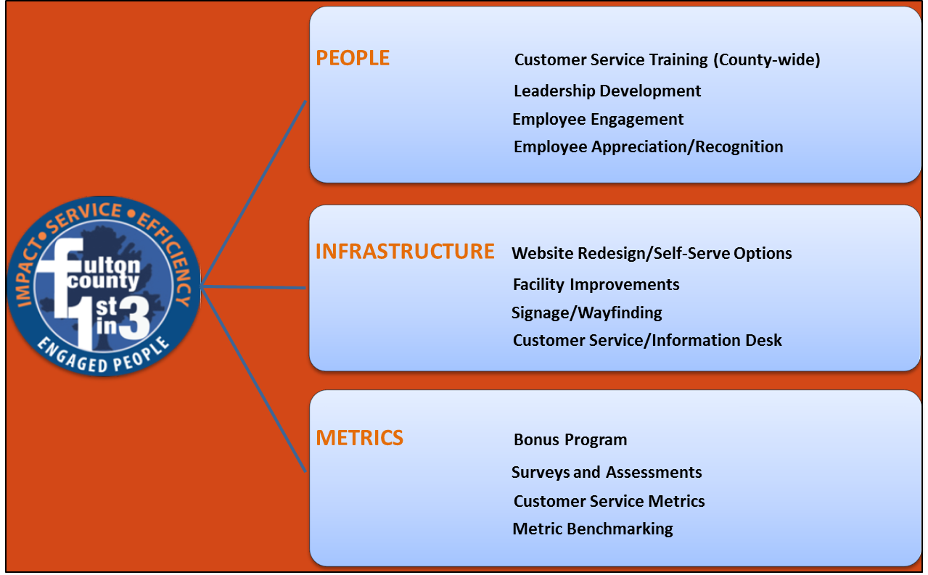
Customer Service Drivers
The customer service drivers outlined below are designed to provide you with a snap shot of areas we touch as a part of the course of action to improved service delivery.

Slide 7


Customer Service
Goals/Strategies
GOAL:
To increase overall customer satisfaction within Fulton County.
STRATEGIES
Continue to identify business process improvements that increase customer satisfaction that positively impact the overall customer experience.
Support digital transformation by increasing digital capabilities and leveraging technology to:
  Increase the amount of the self-serve options available to the citizens.
  Improve service delivery via the county’s website and intranet.
Integrate the County’s adopted customer service policy, which aligns with our core customer service strategies and employee policies into daily operations.
Conduct Customer Satisfaction Surveys to gauge satisfaction progress.

Slide 8
Improving the Customer Experience
A
R
I
S
E
FIVE TIPS TO PROVIDE FIVE STAR CUSTOMER SERVICE
A- Articulate concerns and/or complaints both internally and externally
R- Responsive; respond timely
I- Involve yourself and investigate inquiries
S- Solve; provide viable solutions to concerns; be that problem solver
E- Empathize with customer and show concern for each citizen and employee

Slide 9
QUESTION AND ANSWER
Great Place, Great People, Great Work
Fulton County Customer Service
404-612-4000
CustomerService@fultoncountyga.gov
Helen.Barrow@fultoncountyga.gov Customer Service Coordinator
Brigitte.Bailey@fultoncountyga.gov Director, Customer Experience and Solutions

